Slide 1
BULA
IHO – NIPPON FOUNDATION
ALUMNI SEMINAR

Slide 2
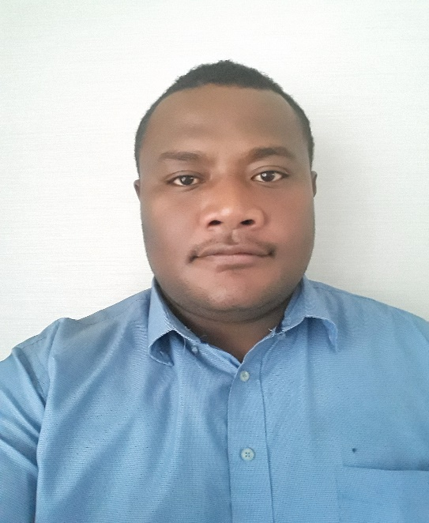
Self introduction
IHO – NIPPON FOUNDATION
ALUMNI SEMINAR
Name | Kelepi Bainivalu
Alumni year | 2017
Country | Fiji
Organization | Fiji Hydrographic Office
Position/Job title | Marine Cartographer
Current job description | To provide guidance to subordinates in Paper Chart updates as per Notice To Mariners. To assist Chief Cartographer in the preparation of Chart Schemes.
Please put your photo here!

Slide 3
My career path and projects / Achievements
IHO – NIPPON FOUNDATION
ALUMNI SEMINAR
Modernization of Fiji’s Paper Chart Folio
Current project involves the conversion of Fiji Chart Folio from the local datum to WGS 84 Datum.

Slide 4
Lessons learned from CHART Course
IHO – NIPPON FOUNDATION
ALUMNI SEMINAR
Importance of understanding the basic principles of chart production and appreciating the conventional methods of compilation.
Always have a paper trail especially in this digital age.
The complexity and skill required to compile ENC Cells.
Paper Chart Production.

Slide 5
Suggestion for the future
IHO – NIPPON FOUNDATION
ALUMNI SEMINAR
Assistance in ENC work attachment for those Alumnae’s whose office haven’t started with ENC production.
Having an e-based plaform where All Alumnae’s can openly discuss and share ideas.

Slide 6
THANK YOU

